Slide 1
Evolutionary Algorithms
Genetic Algorithm I
FAST-NU, Lahore

Slide 2
GENETIC ALGORITHM
Introduction
A biologically inspired model of intelligence
The principles of biological evolution are applied to find solutions to difficult problems
The problems are not solved by reasoning logically about them; rather populations of competing candidate solutions are spawned and then evolved to become better solutions through a process patterned after biological evolution

Slide 3
GENETIC ALGORITHM
Introduction
Less worthy candidate solutions tend to die out, while those that show promise of solving a problem survive and reproduce by constructing new solutions out of their components
GA begin with a population of candidate problem solutions
Candidate solutions are evaluated according to their ability to solve problem instances: only the fittest survive and combine with each other to produce the next generation of possible solutions

Slide 4
GENETIC ALGORITHM
Introduction
Thus increasingly powerful solutions emerge in a Darwinian universe. Learning is viewed as a competition among a population of evolving candidate problem solutions
This method is heuristic in nature and it was introduced by John Holland in 1975

Slide 5
GENETIC ALGORITHM
Basic Algorithm
begin
set time t = 0;
initialise population P(t) = {x₁^{t}, x₂^{t}, …, x_{n}^{t}} of solutions;
while the termination condition is not met do
begin
evaluate fitness of each member of P(t);
select some members of P(t) for creating offspring;
produce offspring by genetic operators;
replace some members with the new offspring;
set time t = t + 1;
end
end

Slide 6
GENETIC ALGORITHM
Basic Attributes of Genetic Algorithm
Genetic representation of candidate solutions (Chromosome)
Population size
Fitness (Evaluation) function
Genetic Operators
Selection algorithm
Generation gap
Amount of elitism used
Number of duplicates allowed

Slide 7
GENETIC ALGORITHM
Chromosome

Slide 8
GENETIC ALGORITHM
Representation of Solutions: The Chromosome
Gene: A basic unit, which represents one characteristic of the individual. The value of each gene is called an allele
Chromosome: A string of genes; it represents an individual i.e. a possible solution of a problem. Each chromosome represents a point in the search space
Population: A collection of chromosomes
An appropriate chromosome representation is important for the efficiency and complexity of the GA

Slide 9
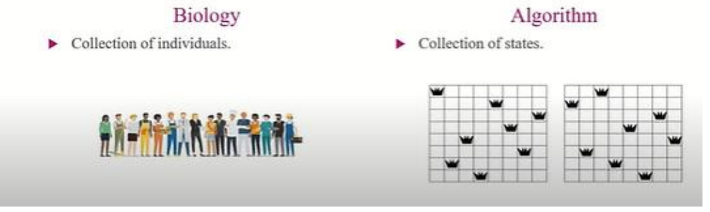
Population: A collection of chromosomes

Slide 10
GENETIC ALGORITHM
Representation of Solutions: The Chromosome
The classical representation scheme for chromosomes is binary vectors of fixed length. However, real valued chromosomes are also possible
In binary coded chromosomes, every gene has two alleles
In real coded chromosomes, a gene can be assigned any value from a domain of values
In the case of an n-dimensional search space, each chromosome consists of n variables with each variable encoded as a bit string

Slide 11
GENETIC ALGORITHM
Representation of Solutions: The Chromosome
Example: Cookies Problem
Two parameters sugar and flour (in kgs). The range for both is 0 to 9 kgs. Therefore a chromosome will comprise of two genes called sugar and flour
5 1 Chromosome # 01
2 4 Chromosome # 02

Slide 12
GENETIC ALGORITHM
Representation of Solutions: The Chromosome
Example: Expression satisfaction Problem
F = (¬a ∨ c) ∧ (¬a ∨ c ∨ ¬e)
∧ (¬b ∨ c ∨ d ∨ ¬e) ∧ (a ∨ ¬b ∨ c)
∧ (¬e ∨ f)
Chromosome: Six binary genes a b c d e f e.g. 100111

Slide 13

GENETIC ALGORITHM
Representation of Solutions: The Chromosome
Example: Model Learning
Use GA to learn the concept Yes Reaction from the Food Allergy problem’s data

Slide 14
GENETIC ALGORITHM
Example: Model Learning
A potential model of the data can be represented as a chromosome with the genetic representation:
Gene # 1 Gene # 2 Gene # 3 Gene # 4
Restaurant Meal Day Cost
The alleles of genes are:
Restaurant gene: Sam, Lobdell, Sarah
Meal gene: breakfast, lunch
Day gene: Friday, Saturday, Sunday
Cost gene: cheap, expensive

Slide 15
GENETIC ALGORITHM
2. Population Size
Number of individuals present and competing in an iteration (generation)
If the population size is too large, the processing time is high and the GA tends to take longer to converge upon a solution (because less fit members have to be selected to make up the required population)
If the population size is too small, the GA is in danger of premature convergence upon a sub-optimal solution (all chromosomes will soon have identical traits). This is primarily because there may not be enough diversity in the population to allow the GA to escape local optima

Slide 16
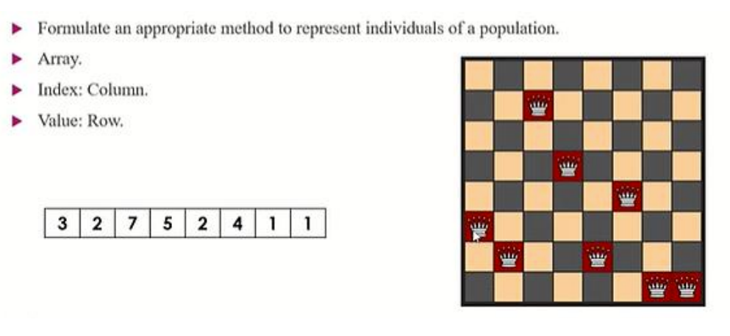
Representing Individuals/States
Example: Model Learning

Slide 17
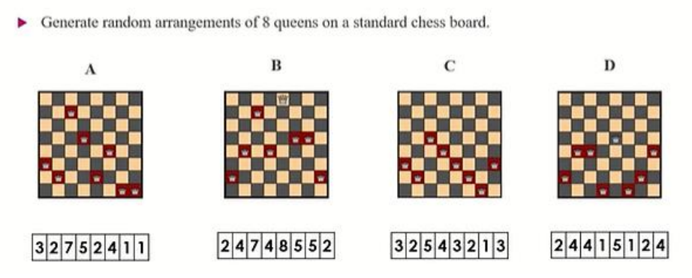
Initial Population

Slide 18
GENETIC ALGORITHM
3. Fitness Function

Slide 19
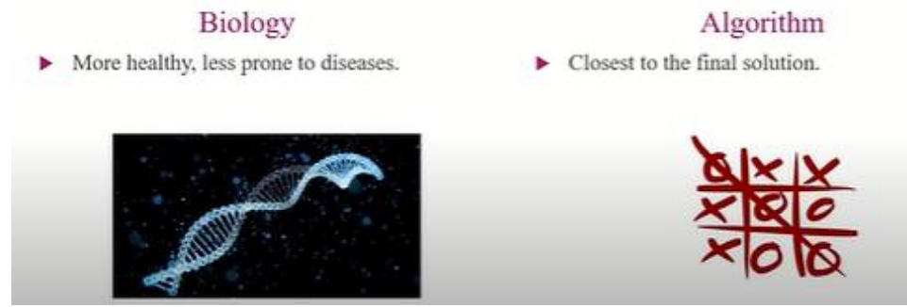
GENETIC ALGORITHM
Fitness Function
Also called “evaluation function”
It is used to determine the fitness of a chromosome
Creating a good fitness function is one of the challenging tasks of using GA

Slide 20
GENETIC ALGORITHM
Fitness Function
Example: Cookies Problem
Two parameters sugar and flour (in kgs). The range for both is 0 to 9 kgs. Therefore a chromosome will comprise of two genes called sugar and flour
5 1
2 4
The fitness function for a chromosome is the taste of the resulting cookies; values can be from 1 to 100

Slide 21
GENETIC ALGORITHM
Example
Find a number: 001010
You have guessed this binary number. If you write a program to find it, then there are 2⁶ = 64 possibilities
If you find it with the help of Genetic Algorithm, then the program gives a number and you tell its fitness
The fitness score is the number of correctly guessed bits

Slide 22
GENETIC ALGORITHM
Example
Find a number: 001010
The fitness score is the number of correctly guessed bits
Step 1. Chromosomes produced.
A) 010101 - 1
B) 111101 - 1
C) 011011 - 4 *
D) 101100 - 3 *
Best ones C & D

Slide 23
GENETIC ALGORITHM
Fitness Function
Example: Model Learning
Use GA to learn the concept Yes Reaction from the data
The fitness function can be the score of the classification accuracy of the rule-set over a set of provided training examples (number of training samples correctly classified by a chromosome)
Often other criteria may be included as well, such as the complexity of the rules or the size of the rule set

Slide 24
GENETIC ALGORITHM
4. Reproduction Operators/Genetic operator

Slide 25
GENETIC ALGORITHM
Reproduction Operators
Genetic operators are applied to chromosomes that are selected to be parents, to create offspring
Basically of two types: Crossover and Mutation
Crossover operator create offspring by recombining the chromosomes of selected parents
Mutation is used to make small random changes to a chromosome in an effort to add diversity to the population

Slide 26
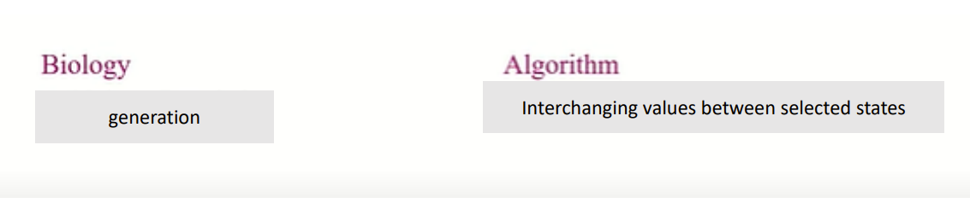
GENETIC ALGORITHM
Reproduction Operators: Crossover
Crossover operation takes two candidate solutions and divides them, swapping components to produce two new candidates

Slide 27
GENETIC ALGORITHM
Reproduction Operators: Crossover
Figure illustrates crossover on bit string patterns of length 8
The operator splits them and forms two children whose initial segment comes from one parent and whose tail comes from the other
Input Bit Strings
1 1 # 0 1 0 1 # # 1 1 0 # 0 # 1
Resulting Strings
1 1 # 0 # 0 # 1 # 1 1 0 1 0 1 #

Slide 28
GENETIC ALGORITHM
Reproduction Operators: Crossover
Two genes sugar and flour (in kgs)
Crossover operation on chromosomes
5 1 5 4
2 4 2 1

Slide 29
GENETIC ALGORITHM
Reproduction Operators: Crossover
The place of split in the candidate solution is an arbitrary choice. This split may be at any point in the solution
This splitting point may be randomly chosen or changed systematically during the solution process
Crossover can unite an individual that is doing well in one dimension with another individual that is doing well in the other dimension

Slide 30
GENETIC ALGORITHM
Reproduction Operators: Crossover
Two types: Single point crossover & Uniform crossover
Single type crossover
This operator takes two parents and randomly selects a single point between two genes to cut both chromosomes into two parts (this point is called cut point)
The first part of the first parent is combined with the second part of the second parent to create the first child
The first part of the second parent is combined with the second part of first parent to create the second child
1000010 1000001
1110001 1110010

Slide 31
GENETIC ALGORITHM
Reproduction Operators: Crossover
Uniform crossover
The value of each gene of an offspring’s chromosome is randomly taken from either parent
This is equivalent to multiple point crossover
1000010
1110001 1010010

Slide 32
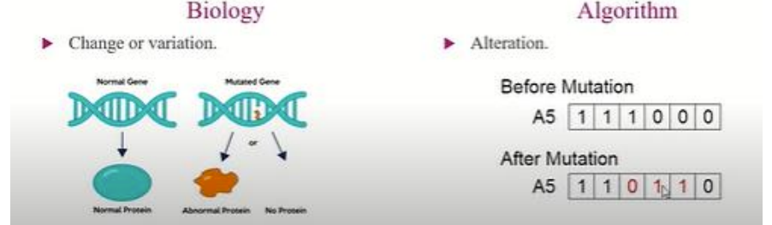
GENETIC ALGORITHM
Reproduction Operators: Mutation
Mutation is another important genetic operator
Mutation takes a single candidate and randomly changes some aspect (gene) of it
For example, mutation may randomly select a bit in the pattern and change it, switching a 1 to a 0 or to # (don’t care)
Notes:
-X-Men, Motants (Movies)

Slide 33
GENETIC ALGORITHM
Reproduction Operators: Mutation
Mutation is important in that the initial population may exclude an essential component of a solution
For example, if no member of the initial population has a 1 in the first position, then crossovers cannot produce a child that could become a solution

Slide 34
GENETIC ALGORITHM
Reproduction Operators: Mutation
Each gene of each offspring is mutated with a given mutation rate p_{μ} (say 0.01)
It is hence possible that no gene may be mutated for many generations. On the other hand more than one gene may be mutated in the same generation (or even in the same chromosome)

Slide 35
GENETIC ALGORITHM
Reproduction Operators: Mutation
For real valued genes, the value is selected randomly from the alleles
If the rate is too low, new traits will appear too slowly in the population. If the rate is too high, each generation will be unrelated to the previous generation

Slide 36
GENETIC ALGORITHM
Reproduction Operators: Crossover (Important Similarities)
Suppose we have these chromosomes and their fitness values
A) 01101 169
B) 11000 576
C) 01000 64
D) 10011 361
If we analyze the strings which have high fitness value, we have observe that they both have a 1 in the 1st column, whereas the low fitness strings have a 0. In the second column we have a 1 in B and 0 in D, and 1 in the low fitness strings. We wonder that if 1 in the 2nd column is associated with low fitness, so we may improve the score of B by putting a 0 in place of 1 in the 2nd column

Slide 37
GENETIC ALGORITHM
Example#1
Find a number: 001010
You have guessed this binary number. If you write a program to find it, then there are 2⁶ = 64 possibilities
If you find it with the help of Genetic Algorithm, then the program gives a number and you tell its fitness
The fitness score is the number of correctly guessed bits

Slide 38
GENETIC ALGORITHM
Example
Find a number: 001010
Step 1. Chromosomes produced.
A) 010101 - 1
B) 111101 - 1
C) 011011 - 4 *
D) 101100 - 3 *
Best ones C & D

Slide 39
GENETIC ALGORITHM
Example
Find a number: 001010
Mating New Variants Evaluation
C) 01:1011 01:1100 (E) 3
D) 10:1100 10:1011 (F) 4 *
C) 0110:11 0110:00 (G) 4 *
D) 1011:00 1011:11 (H) 3
Selection of F & G

Slide 40
GENETIC ALGORITHM
Example
Mating New Variants Evaluation
F) 1:01011 1:11000 (H) 3
G) 0:11000 0:01011 (I) 5 *
F) 101:011 101:000 (J) 4 *
G) 011:000 011:011 (K) 4
Selection of I and J

Slide 41
GENETIC ALGORITHM
Example
Mating New Variants Evaluation
I) 0010:11 0010:00 (L) 5
J) 1010:00 1010:11 (M) 4
I) 00101:1 00101:0 (N) 6 (success) *
J) 10100:0 10100:1 (O) 3
In this game success was achieved after 16 questions, which is 4 times faster then checking all possible 2⁶ = 64 combination

Slide 42
Chromosome Encoding for Simplified Time Table
Courses = 16 (C1, C2, …..C16)
Teachers = 8 (T1, T2, T3,……T8)
Days = 5 (Mon, Tues, Wed, Thurs, Fri)
Time-Slots = 5 (9-10, 10-11, 11-12, 12-1, 1-2)
Classrooms = 4 (R1, R2, R3, R4)
Chromosome encoding (Binary encoding)?
Size of chromosome?

Slide 43
GENETIC ALGORITHM
Representation of Solutions: The Chromosome
Rules Representation
Rules are often represented by bit strings (because they can be easily manipulated by genetic operators), but other numerical and symbolic representations are also possible
Set of if-then rules:
Specific sub-strings are allocated for encoding each rule pre-condition and post-condition
Example: Suppose we have an attribute “Outlook” which can take on values: Sunny, Overcast or Rain

Slide 44
GENETIC ALGORITHM
Representation of Solutions: The Chromosome
Rules Representation
We can represent it with 3 bits:
100 would mean the value Sunny,
010 would mean Overcast &
001 would mean Rain
110 would mean Sunny or Overcast
111 would mean that we don’t care about its value
The pre-conditions & post-conditions of a rule are encoding by concatenating the individual representation of attributes

Slide 45
GENETIC ALGORITHM
Representation of Solutions: The Chromosome
Rules Representation
Example:
If (Outlook = Overcast or Rain) and Wind = strong
then PlayTennis = No
can be encoded as 0111001
Another rule
If Wind = Strong then PlayTennis = Yes
can be encoded as 1111010

Slide 46
GENETIC ALGORITHM
Representation of Solutions: The Chromosome
Rules Representation
An hypothesis comprising of both of these rules can be encoded as a chromosome 01110011111010
Note that even if an attribute does not appear in a rule, we reserve its place in the chromosome, so that we can have fixed length chromosomes
Note that 01110011111011
would mean, we do not care whether we play tennis or not

Slide 47
GENETIC ALGORITHM
Representation of Solutions: The Chromosome
Variable size chromosomes
Sometimes we need a variable size chromosome; e.g. to represent a set of rules
Example:
Suppose we are representing a set of rules by a chromosome
If a1 = T and a2 = F then c = T
If a2 = T then c = F
If there is only the 1st rule in the set, we have 10 01 1
If the rule set has 1st & 2nd rules then we have 10 01 1 11 10 0

Slide 48
GENETIC ALGORITHM
References
Engelbrecht Chapter 8 & 9

